Slide 1

6th Grade Accelerated Math
Unit 7, Lesson 5 Finding the Area of Trapezoids, Parallelograms, and Rhombi Volume 1, pg. 322

Slide 2


Benchmark
MA.7.GR.1.1
Apply formulas to find the areas of trapezoids, parallelograms, and rhombi.
volume 1, pg. 322

Slide 3
Integrated Mathematical Thinking and Reasoning Standards
MA.K12.MTR.1.1 Actively participate in effortful learning both individually and collectively.
MA.K12.MTR.5.1 Use patterns and structure to help understand and connect mathematical concepts.
MA.K12.MTR.7.1 Apply mathematics to real-world contexts.
volume 1, pg. 322

Slide 4

Learning Target
I can find the area of trapezoids, parallelograms, and rhombi.
volume 1, pg. 322

Slide 5

Warm-Up
volume 1, pg. 322

Slide 6

7.5.1 Warm-Up: A Day in the Life
Betsy McIver, a mechanical engineer, works in the Walt Disney Imagineering area and designs systems for the interactive attractions at the theme park. She mentions that her job can include creative left-brain thinking, as well as technical right-brain thinking. She says that to be successful at her job, it is important to understand math, design, and theatre. She also mentions that many disciplines, such as designers and architects, all work together to make everything possible in the entertainment engineering industry.
1. Describe a ride you saw that looked exciting and entertaining.
volume 1, pg. 322

Slide 7

Guided Instruction
volume 1, pg. 323

Slide 8
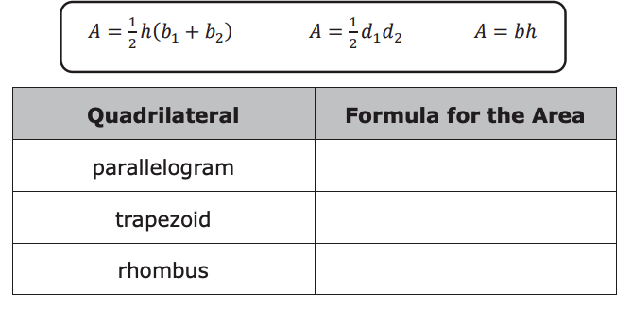
7.5.2 Guided Instruction: Area of Parallelograms, Trapezoids, and Rhombi
1. Complete the table to match each type of quadrilateral with the formula to find its area.
volume 1, pg. 323

Slide 9
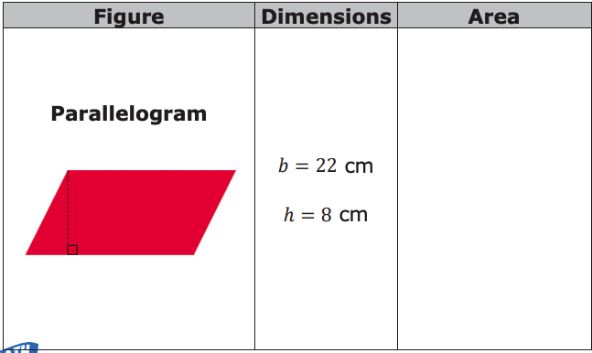
2. The dimensions of three quadrilaterals are given in the table. Label each figure shown with the given dimensions in centimeters (cm). Then, calculate the area of each figure using the appropriate formula. Show your work.
volume 1, pg. 323

Slide 10
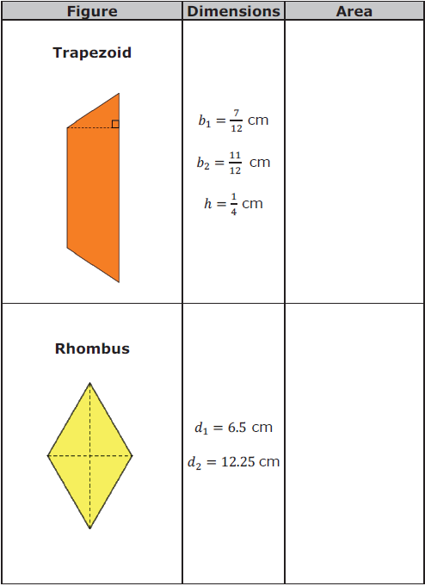
volume 1, pg. 323

Slide 11

Your Turn
volume 1, pg. 324

Slide 12
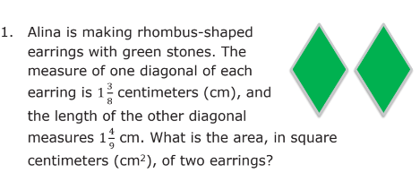
7.5.3 Your Turn!
volume 1, pg. 324

Slide 13
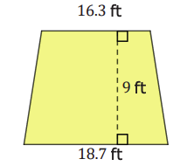
2. One wall of Kel’s apartment is shaped like a trapezoid with one base 18.7 feet (ft), the other base 16.3 ft, and a height of 9 ft.
Kel plans to paint this wall blue and needs to know how much paint to buy. What is the area of the wall Kel plans to paint?
volume 1, pg. 324

Slide 14
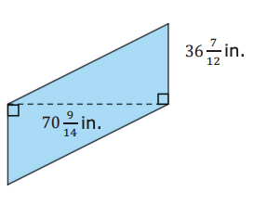
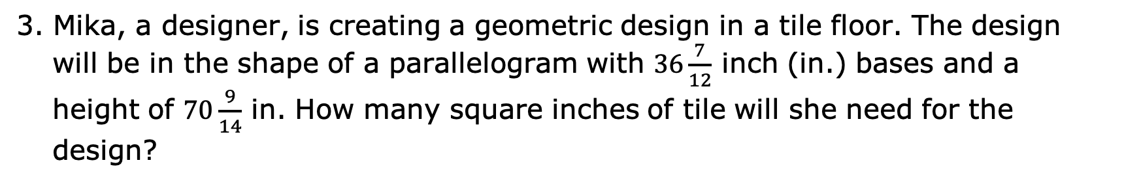
3. Mika, a designer, is creating a geometric design in a tile floor. The design will be in the shape of a parallelogram with $36\frac{7}{12}$ inch (in.) bases and a height of $70\frac{9}{14}$ in. How many square inches of tile will she need for the design?
volume 1, pg. 324

Slide 15
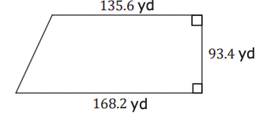
4. The Smart family’s horse pasture is in the shape of a trapezoid. One of the parallel sides is 168.2 yards (yd) long and the other is 135.6 yd long. The distance between these sides is 93.4 yd.
What is the area of the horse pasture?
volume 1, pg. 324

Slide 16
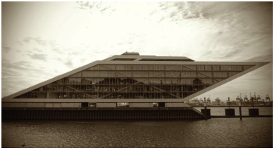
5. The Dockland Building in Hamburg, Germany is shaped like a parallelogram.
If the base of the building is 86 meters (m) and its height is 47 m, what is the area of the face of the building shown in the image?
volume 1, pg. 325

Slide 17

Wrap-Up
volume 1, pg. 325

Slide 18
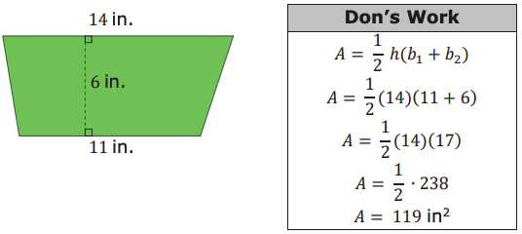
7.5.4 Wrap-Up: Ticket Out the Door
Don’s work for finding the area of the trapezoid is shown below.
Write Don a note explaining what he did correctly and where he made an error.
What is the area of the trapezoid?
volume 1, pg. 325

